Slide 1
One-to-one biases in a non-linguistic and non-communicative domain: 30-month-olds map novel animal vocalizations to unfamiliar animals
Ricardo A.H. Bion, Kyle MacDonald, Anne Fernald

Slide 2
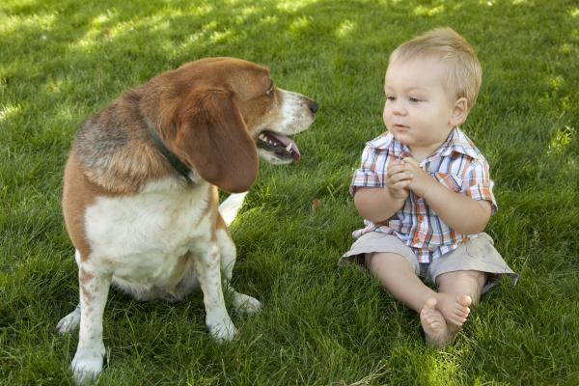
Notes:
As children interact with objects, people, and animals in their environment, they create many associations between these entities and different meaningful sounds.
In a context like this, the child might learn that this animal is called dog.

Slide 3
That's a dog!
Notes:
And as we all know, decades of research have explored how children create mapping between novel words and objects, and on how children develop proficiency in interpreting these mappings during their first years of life.
But in this same context, the child might also learn several other meaningful associations.

Slide 4
woof
That's a dog!
Look at the
bow-wow!
Notes:
For example, the child might learn that this animal is also called "bow-wow," an onomatopoeic word representing the sound that dogs make.
Or the child might learn that dogs bark, creating a link between dogs and their typical vocalization.

Slide 5
animal names
animal vocalizations
onomatopoeic words
woof
That's a dog!
Look at the
bow-wow!
Notes:
Animal names, animal vocalizations, and onomatopoetic words, differ in arbitrariness but they provide consistent meaningful associations between complex and distinct sounds and common objects in children’s environments

Slide 6
Animal names, onomatopoeic words, and vocalizations allow us to investigate:
Children's efficiency in processing linguistic and non-linguistic sounds
The domain-specificity of leaning mechanisms
Notes:
I am particularly interested in these three types of auditory cues because they allow us to compare children's efficiency in processing linguistic and non-linguistic sounds
And they also allow us to investigate the domain-specificity of learning mechanisms

Slide 7
How do children create linguistic and non-linguistic sounds-object associations?
Learning animal vocalizations appears trivial
Word learning is treated as a complex problem of induction (e.g., Markman, 1991)
Notes:
One of the reasons why there's so little research on how children learn and recognize animal vocalizations and environmental sounds in general might be because this kind of learning might seem trivial. Animal vocalizations are causally connected to the animals who produced them; they can be determined by the shape of their vocal track; they are accompanied by synchronous mouth movements; and they can be identified by paying attention to the origin of the sound
In contrast, word learning is seen as a complex problem of induction. In order to figure what a novel word refers to, many researchers argue that children are equipped with constraints on the possible meaning of words.

Slide 8

Where's the dofa?
The bias of mapping a novel word
onto a novel object is known as disambiguation
Notes:
One of the biases that might help children learn the meaning of words is their tendency to map a novel word onto a novel object
There has been recent debate on the importance of these biases for early word learning,
but disambiguation biases have been consistently demonstrated in children two years and older, with less robust effect emerging at earlier ages.

Slide 9
Why do children select a novel object when hearing a novel word?
A lexical phenomenon (de Marchena et al., 2011)
A product of children’s theory of mind (Bloom, 2002; Diesendruck & Markson, 2001)
A general principle of learning (Frank et al, 2011; McMurray et al., 2011)
Notes:
There has been three main theories about the scope of these strategies. That is, why do children select a novel object when hearing a novel word.
Some authors claim that it is a lexical phenomenon that applies only to words
others that it is a product of children’s theory of mind restricted to communicative situations
and more recent approaches explain it is a special case of a general principle of learning that looks for regularities across domains

Slide 10
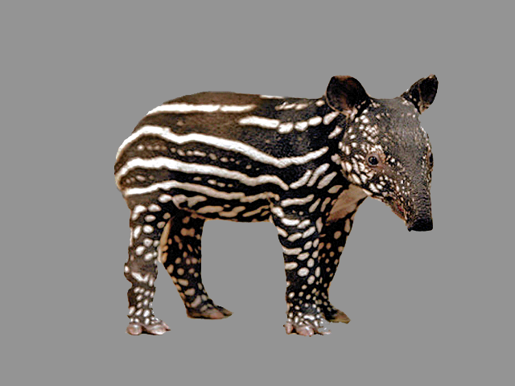
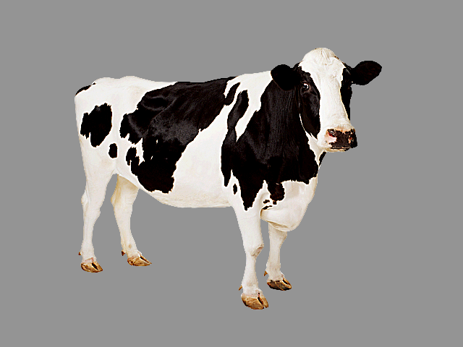
Animal sounds are non-linguistic and non-communicative for humans
"It would be nice to know if [disambiguation biases] apply when children learn the sounds that different animals make"
(Bloom, 2001, pp69)
Notes:
And as Paul Bloom acknowledged in his book How Children Learn the Meaning of words, animal vocalizations are an interesting way to test these different theories
because they are non-linguistic, and non-communicative for humans. Therefore, if young children showed disambiguation biases for the vocalizations that animals produce
This could be seen as evidence in favor of domain-general accounts of disambiguation.
"It would be nice to know if [disambiguation biases] apply when children learn the sounds that different animals make"
(Bloom, 2001, pp69)

Slide 11
STUDY 1
How quickly can 30-mo-olds use linguistic and non-linguistic cues to identify a familiar animal?
Do children choose a novel animal in response to a novel animal vocalization?
STUDY 2
If so, do children actually remember the mapping between the novel animal and vocalization?
Notes:
We focused on three different research questions.
We first ask how

Slide 12
STUDY 1
How quickly can 30-mo-olds use linguistic and non-linguistic cues to identify a familiar animal?
Do children choose a novel animal in response to a novel animal vocalization?
STUDY 2
If so, do children actually remember the mapping between the novel animal and vocalization?
Notes:
The first study focuses on the first two questions.

Slide 13
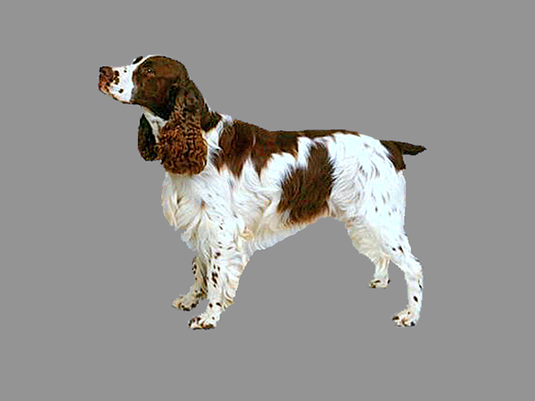
Children's recognition of the link between a familiar sound and a familiar animal
Where’s the dog?
(animal name)
Which one goes woof-woof?
(onomatopoeic word)
Listen [dog barking]
(animal vocalization)
30-month-olds (n=21)
Notes:
We had two different trial types. In half the trials, children saw two familiar animals or a familiar and a novel animal, and heard a familiar sound.
This sound could be a familiar animal name.
A familiar onomatopoeic word.
Or a familiar animal vocalization.

Slide 14
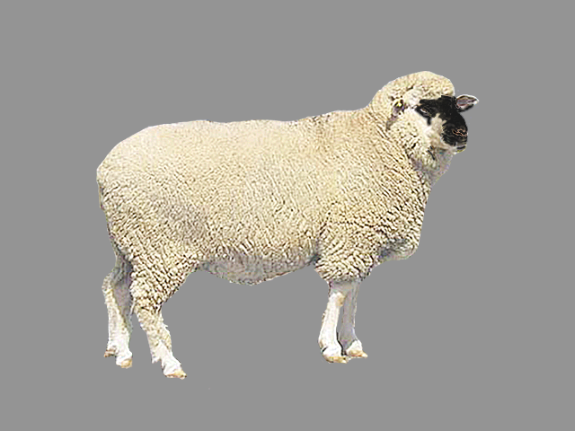

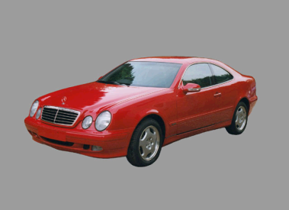
Children see a familiar and novel animal and hears a novel sound
Where’s the nadu?
(animal name)
Listen [novel vocalization]
(animal vocalization)
30-month-olds (n=21)
Notes:
In the other half of trials, children saw a familiar and a novel animal and heard a novel sound.
There were two kinds of novel sounds, a novel animal name, and a novel animal vocalization.

Slide 15
Measures of processing efficiency
Accuracy: Proportion looking to the target animal [300 to 4300 ms]
RT: Time to shift to the target animal when looking at the distractor animal
Notes:
In all trials, we looked at children's accuracy and RT.

Slide 16
STUDY 1
How quickly can 30-mo-olds use linguistic and non-linguistic cues to identify a familiar animal?
Do children choose a novel animal in response to a novel animal vocalization?
STUDY 2
If so, do children actually remember the mapping between the novel animal and vocalization?
Notes:
Now let's go directly to our first question.

Slide 17
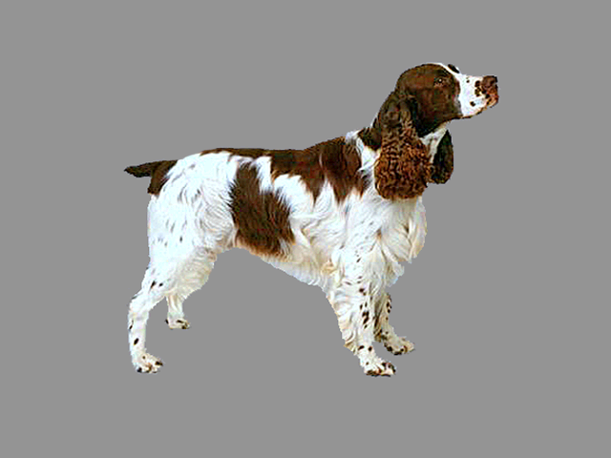
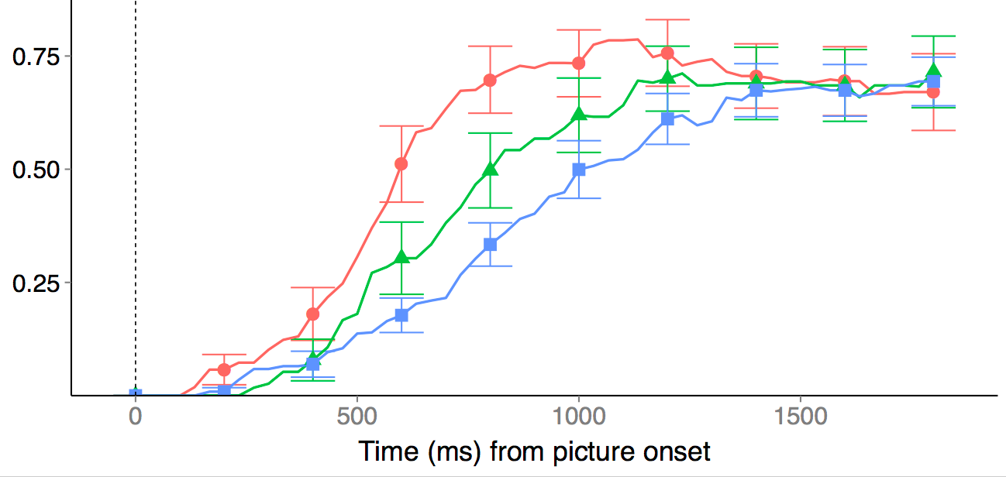
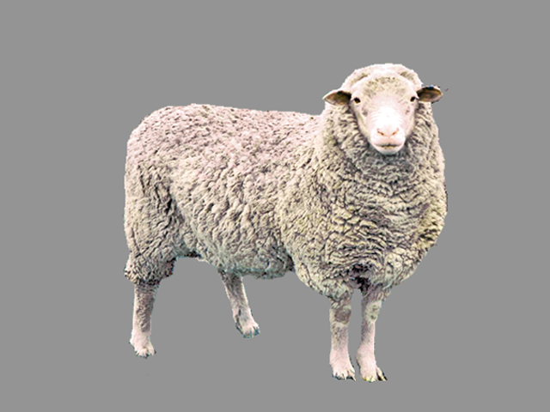
30-mo-olds were fastest to orient to a familiar animal in response to the animal name, and slowest in response to the animal vocalization
D O G
W O O F
% looking
to target animal
[barking]
animal name (650ms - FAST)
onomatopoeic word (828ms)
animal vocalization (906ms - SLOW)
time (ms) from sound onset
Children were reliably above chance on the three conditions

Slide 18
30-mo-olds were fastest to orient to a familiar animal in response to the animal name, and slowest in response to the animal vocalization
D O G
Why?
• Frequency
• Design features
• Representational
W O O F
% looking
to target animal
[barking]
animal name (650ms - FAST)
onomatopoeic word (828ms)
animal vocalization (906ms - SLOW)
time (ms) from sound onset
Children were reliably above chance on the three conditions
Notes:
Differences in signal characteristics (e.g., higher information density at signal onset for words than natural animal sounds)
Massive differences in frequency of exposure between animal names and animal vocalizations
Representational differences (e.g., words refer, words connect to the lexical system, words activate more general concepts)

Slide 19
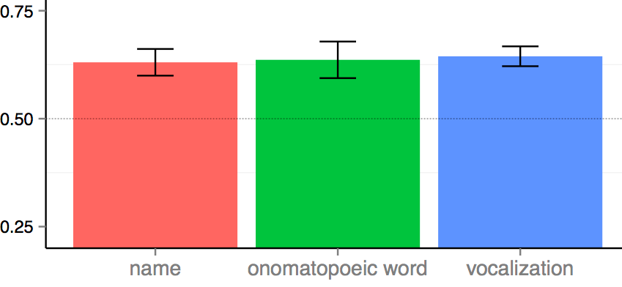
But they all get the job done!
% looking at correct animal
Notes:
But the important take home message is that all the three different sounds get the job done.
Children looked at the correct animal when hearing the animal name, an onomatopoeic word, and an animal vocalization, with accuracy indistinguishable across conditions.

Slide 20
STUDY 1
How quickly can 30-mo-olds use linguistic and non-linguistic cues to identify a familiar animal?
Do children choose a novel animal in response to a novel animal vocalization?
STUDY 2
If so, do children actually remember the mapping between the novel animal and vocalization?
Notes:
Our second question focuses on the domain-generality of disambiguation biases. We asked whether children would map a novel animal vocalization to a novel animal.

Slide 21
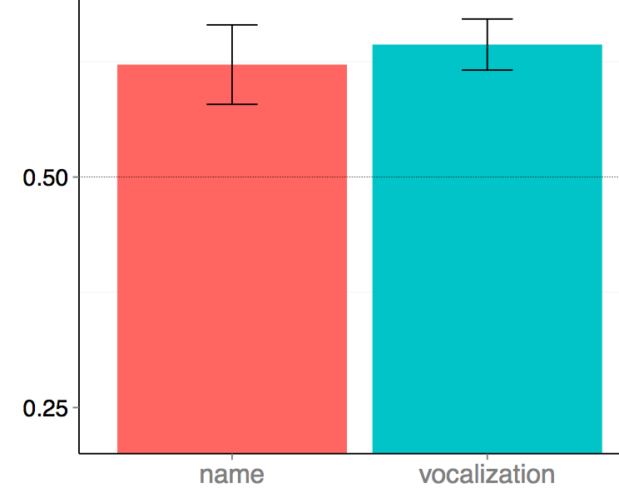

When a novel animal was paired with a familiar animal, children were above chance in choosing the novel animal in response to a novel animal name or vocalization
% looking at novel animal
Novel
name
Novel
vocalization
No differences in accuracy and RT between conditions
Notes:
When a novel animal was paired with a novel animal vocalization, children looked at the novel animal.

Slide 22
When a novel animal was paired with a familiar animal, children were above chance in choosing the novel animal in response to a novel animal name or vocalization
• Favor domain-generality
• Earliest age of nonlinguistic disambiguation
% looking at novel animal
Novel
name
Novel
vocalization
No differences in accuracy and RT between conditions
Notes:
This is the earliest age at which one-to-one biases have been observed in a domain other than word learning.
Our results cannot be easily explained by pragmatic or lexical-constraints accounts, and seem to favor a domain-general learning mechanism that seeks simple regularities in complex learning tasks
While words might be a particularly effective cue to identify familiar animals, words and animal vocalizations seem to be equally effective cues to disambiguate novel animals

Slide 23
Fast mapping, slow learning
18-month-olds succeed on familiar-word trials,
but are at chance on disambiguation and retention
24-month-olds succeed on familiar-word and disambiguation trials, but are at chance on retention
30-month-olds succeed on familiar words, disambiguation, and retention trials
Bion, Borovsky, & Fernald (2012) Cognition
Notes:
We showed that children show disambiguation biases for a novel animal vocalization.
But it is not clear whether children could use this strategy to learn about novel sounds in their environment.

Slide 24
STUDY 1
How quickly can 30-mo-olds use linguistic and non-linguistic cues to identify a familiar animal?
Do children choose a novel animal in response to a novel animal vocalization?
STUDY 2
If so, do children actually remember the mapping between the novel animal and vocalization?

Slide 25
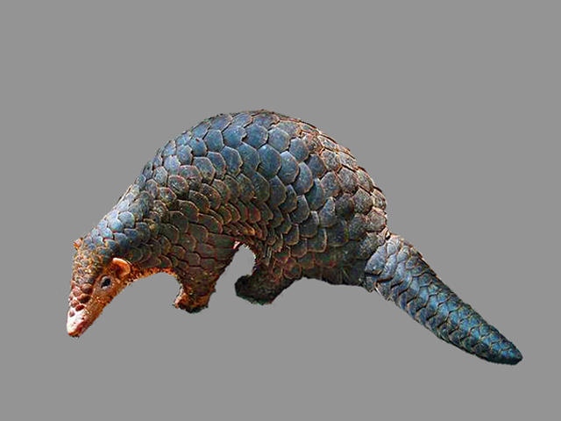
30-month-olds (n = 20) in Familiar, Disambiguation, and Retention trials
Familiar vocalization
(e.g., barking)
Disambiguation of
novel vocalization
(e.g., grunting)
Retention of
novel vocalization
(e.g., grunting)
Focus exclusively on animal vocalizations
Notes:
We had three different trial types.

Slide 26
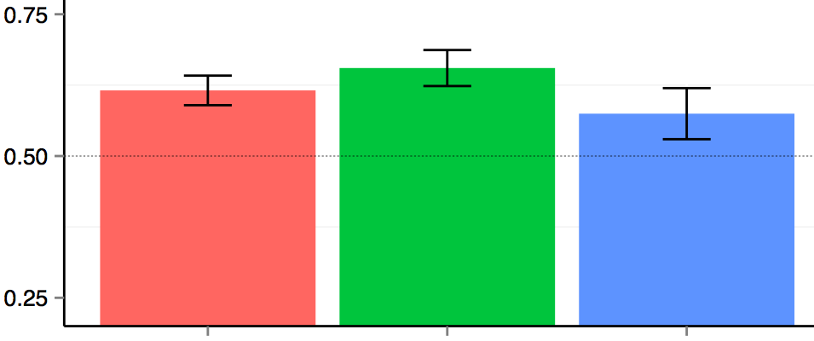
Children reliably chose the novel animal in response to the novel animal vocalization, but showed fragile evidence of remembering this mapping on retention trials
% looking
to target
animal
Familiar
Disambiguation
Retention

Slide 27
Children who are better at disambiguating the novel animal vocalizations were better at retention
r (18) = 0.44, p = 0.05
Mean accuracy on
Retention trials
Mean accuracy on Disambiguation trials
Notes:
Correlation is there even when removing the two outliers.

Slide 28
30-mo-olds were fastest to orient to a familiar animal in response to the animal name, and slowest in response to the animal vocalization
When a novel animal was paired with a familiar animal, children were above chance in choosing the novel animal in response to a novel animal name or vocalization
Disambiguation biases in nonlinguistic domains are related - but should not be conflated – with the retention of the mapping between an animal and a sound

